Slide 1




Government of Khyber Pakhtunkhwa
Energy & Power Department
KPOGCL
ENERGY SECURITY of PAKISTAN via
Indigenous Oil & Gas Exploration
Presentation to Press
13-Oct-2015
-
29-09-2015

Slide 2
PAKISTAN ENERGY SECURITY
KP is blessed with large Oil & Gas reserves –a new geological frontline
KPOGCL formed to facilitate Oil and gas Exploration & Production companies in KP
Annual KP Production can reach 160,000 barrels/day
National Savings Annual: $ 3.5 Billion
Annual KP Gas Production can reach 1.5 billion cubic feet
National Savings Annual: $ 5.7 Billion
Seepages in millions of $ evaporating
2

Slide 3
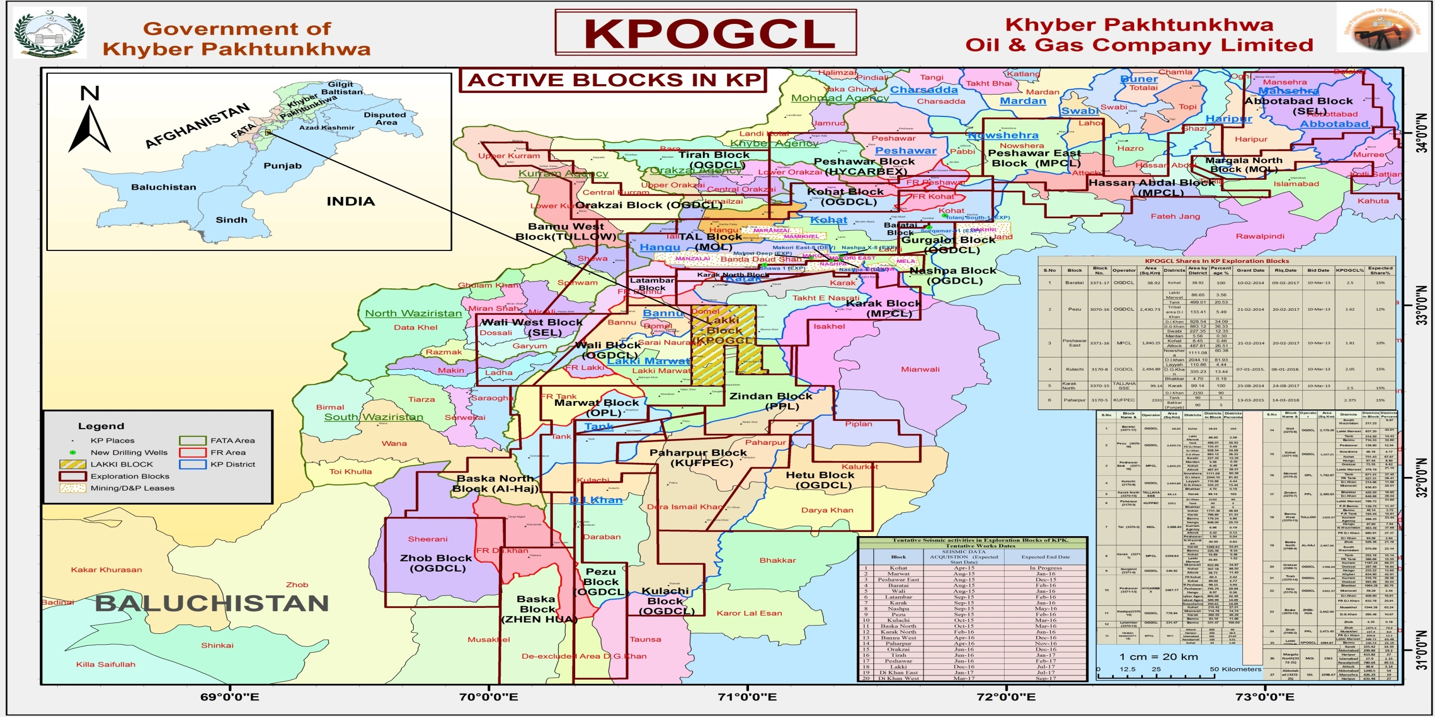

Slide 4
Recoverable Potential of KP
10 TCF Gas
600 Million Barrels of Oil

Slide 5
KPK Exploration Blocks
S.No | Exploration License | Active 2015 | Inactive 2013
1. | TAL | Gravity Survey | Some work/Production
2. | PESHAWAR EAST | Seismic Nov | √
3. | PESHAWAR | Scouting in progress | √
4. | MARWAT | Seismic Oct-2015 | √
5. | BANNU WEST |  | √
6. | LATAMBAR | Seismic | √
7. | WALI | Geological Survey | √
8. | ORAKZAI | Geological Survey | √
9. | GURGALOT | Drilling
10. | NASHPA | Drilling | Production
11. | KOHAT | Seismic In progress | √
12 | PEZU | Seismic Nov-2015 | √
13 | TIRAH |  | √
14 | BARATAI | Seismic Sept-2015 | √
15 | KARAK | Drilling In progress | √
16 | BASKA |  | √
17 | KARAK NORTH | Scouting in progress | √
18 | BASKA NORTH |  | √
19 | ZINDAN | Drilling In progress | √
20 | PAHARPUR | Seismic April 2016 | √
21 | KULACHI | Seismic Nov-2015 | √

Slide 6

STATUS OF EXPLORATION & PRODUCTION ACTIVITIES IN KHYBER PAKHTUNKHWA SINCE 2013.
KHYBER PAKHTUNKHWA OIL & GAS COMPANY LIMITED (KPOGCL)

Slide 7
STATUS OF EXPLORATION & PRODUCTION ACTIVITIES IN KHYBER PAKHTUNKHWA SINCE 2013.
KHYBER PAKHTUNKHWA OIL & GAS COMPANY LIMITED (KPOGCL)

Slide 8
STATUS OF EXPLORATION & PRODUCTION ACTIVITIES IN KHYBER PAKHTUNKHWA SINCE 2013.
KHYBER PAKHTUNKHWA OIL & GAS COMPANY LIMITED (KPOGCL)

Slide 9
STATUS OF EXPLORATION & PRODUCTION ACTIVITIES IN KHYBER PAKHTUNKHWA SINCE 2013.
KHYBER PAKHTUNKHWA OIL & GAS COMPANY LIMITED (KPOGCL)

Slide 10
PRODUCTION FORECAST OF OIL, GAS & LPG IN KHYBER PAKHTUNKHWA (Conservative Scenario)
KHYBER PAKHTUNKHWA OIL & GAS COMPANY LIMITED (KPOGCL)

Slide 11
KPOGCL to Coordinate
A Provincial Holding Company by the Federal Government
Letter from Energy & Power Deptt, Government of Khyber Pakhtunkhwa to Ministry of Petroleum – attached at Annex-A
Letter from Home Dept to all Commissioners and Regional Police Officers - attached at Annex-B
Letter from Director General Petroleum Concession to oil and gas Exploration & Production and Service Companies - attached at Annex-C

Slide 12
PRODUCTION FORECAST OF OIL, GAS & LPG IN KHYBER PAKHTUNKHWA (Conservative Scenario)
KHYBER PAKHTUNKHWA OIL & GAS COMPANY LIMITED (KPOGCL)

Slide 13
PRODUCTION FORECAST OF OIL, GAS & LPG IN KHYBER PAKHTUNKHWA (Conservative Scenario)
KHYBER PAKHTUNKHWA OIL & GAS COMPANY LIMITED (KPOGCL)

Slide 14

Crude Oil Production & Use
(Pakistan Energy Year Book 2014)

Slide 15
Natural Gas Production
(Pakistan Energy Year Book 2014)

Slide 16

Thanks
Q&A
RAZIUDDIN (RAZI)
CEO
KP Oil & Gas Company Ltd. (KPOGCL)
www.kpogcl.com.pk
Cell +92 300 500 1038, +92 333 538 0240
Phone: +92 91 5615142-8 Fax: +92 91 5615149
Email: razi.ceo@kpogcl.com.pk
Peshawar, PAKISTAN
KHYBER PAKHTUNKHWA OIL & GAS COMPANY LIMITED (KPOGCL)

